Slide 1
UFCFB6-30-2 Object-oriented Software Development
Unit 5 Identify classes
Benedict R. Gaster
2016-17

Slide 2
Outline
Textual analysis
CRC technique
More inheritance examples

Slide 3
How to identify candidate classes?
Vocabulary analysis of use cases. Noun analysis focus on the essential properties of the problem domain
ABSTRACTION
Analyse NOUNS (in use cases etc.)
Cluster Classes from Objects
Whole Objects / Component Parts
Reject Synonyms
Evaluate Scope

Slide 4
Some helpful guides
Part of speech | Model component | Example
proper noun | instance | J. Smith
improper noun | class/type/role | toy
doing verb | operation | buy
being verb | classification | is an
having verb | composition | has an
transitive verb | operation | enter
Notes:
prop·er noun
Noun
A name used for an individual person, place, or organization, spelled with initial capital letters, e.g., Larry or Mexico.
An improper noun is a noun that is used to describe places, things and the people generally. Examples of improper nouns include; cat, day, city, month and bridge. It is the opposite of a proper noun that describes the name of an individual, object or place.
A transitive verb has two characteristics. First, it is an action verb, expressing a doable activity like kick, want, paint, write, eat, clean, etc. Second, it must have a direct object, something or someone who receives the action of the verb.
As we have suggested, most object-oriented analysis methods give little help on the process of identifying objects. It is a very reasonable approach to engage in the analysis of nouns, verbs and other parts of speech in an informal written description of the problem or a set of use case post-conditions. Rules of thumb here include: matching proper nouns to instances, and improper nouns to types or attributes; adjectival phrases qualifying nouns such as 'the employee who works in the salaries department' indicate relations or may indicate methods if they contain verbs as in 'the employee who got a rise'.

Slide 5
An example of vocabulary analysis
A requirements statement transcript might contain the following fragment:
... If a customer enters a store with the intention of buying a toy for a child, then advice must be available within a reasonable time concerning the suitability of the toy for the child. This will depend on the age range of the child and the attributes of the toy. If the toy is a dangerous item, then it is unsuitable. ...
Candidate classes(nouns) are in bold
Candidate methods (transitive verbs) are italicized
But it must be understood that this is not a formal technique in any sense of the word. The table is intended merely to provoke thought during analysis.

Slide 6
How to identify candidate classes?
Step 1: Find the nouns and verbs
Nouns may suggest:
Object (useful as test data)
Class
Attribute
Attribute value (useful as test data)
Verbs may suggest:
Class relationships, e.g. association
Operation
Notes:
Choosing the nouns and noun phrases is not an exact science. For example, in the second sentence of the above description, the object of the verb ‘have’ is the noun phrase ‘any number of copies of each film’. Instead of underlining this phrase as a whole we have chosen to identify ‘number of copies’ and ‘film’ separately within the phrase. In doing this we are intuitively deciding that both copies and films are likely to be of importance. Another example is the noun ‘loan’, which could be treated as part of the phrase ‘is on loan to the member’ (describing the status of a DVD) rather than as a noun in its own right. This is only the first stage of identifying classes. We will shortly analyse the candidate classes in more detail.

Slide 7
How to identify candidate classes?
Step 2: Evaluate the nouns to find classes
Questions to ask to evaluate nouns to find classes:
Is the term needed within the scope of the project?
If so, then does the noun qualify as a problem domain resource? Think of an appropriate class name
Otherwise, is the noun an example of a class, for example, an object, an instance of a class?
Otherwise, is the noun an attribute of a class? What class?
Otherwise, is the noun an example of an attribute, for example, an attribute value?
Notes:
3.2.4 Guidelines for rejection of candidate classes
Though there are no hard and fast rules, your answers to the following questions should give you a strong indication of whether or not an entity really should be modelled using a class. Although, strictly speaking, it is the category of entity that is modelled by a class, we shall often use the word entity as if it were a category.
Is it a property?
Is it simply a property of some other type of entity in the system domain, or does it contribute to the system domain in its own right? If the former, it is likely to be appropriately modelled by an attribute of a class rather than a class itself.
As you will see below, a good test of whether an entity should be modelled using a class or an attribute is whether it has or does not have properties itself. If it has properties, then it is likely to be appropriately modelled by a class; if not, then it is likely to be appropriately modelled by an attribute.
Some examples of attributes from the DVD Library are:
title – an attribute of a film;
identifying number – an attribute of a DVD;
membership number – an attribute of a member;
member's name – another attribute of a member;
number of copies available – an attribute of film (but see further discussion below);
return date – an attribute of a loan;
date on which it was borrowed – an attribute of a loan.
What about ‘day'? Number of days is also a property of a loan. However, as all loans are of the same duration – three days – there is no need to record this information for each loan. You will see later how this information is taken into account.
Having decided above that ‘number of copies available’ is to be modelled by an attribute of a film, should ‘number of copies’ (that is, the total number of copies of a film, whether on loan or not) also be modelled by an attribute of a film? As you will see below, we believe that it is more appropriate to model ‘number of copies’ in terms of links between films and DVDs.
Does it refer to a behaviour of the system?
Does it name some process or result of a process that the system has to carry out?
In the DVD Library, a ‘list’ (of the film titles and return dates for each DVD) is something that the system needs to produce as part of its behaviour, rather than a category of entities that is significant for the system domain itself.
Something else that could fit into this category is ‘number of copies available’. We have identified DVD (copy) as another candidate class, and the number of copies available is something that the system is required to produce. However, ‘number of copies available’ can also be viewed as an attribute of a film, which is how we have chosen to model it.
Is it outside the scope of the system?
Is it a word or phrase that is used to help describe the general purpose of the system or what it consists of, but that does not actually refer to significant entities in the system domain?
The ‘library’ itself falls into this category. The system will operate in the context of the library, but will not need to represent the library per se. The significant entities are those with which the library is concerned – its members, DVDs etc. You could think of the library as being the boundary of the system domain. Had the system been required to administer a group of libraries, then ‘library’ might have given rise to a class, since it would probably be important to know, for example, which copy of a film was held at which library.
Things such as ‘user’ or, in the case of the DVD library, ‘library staff, also fall into this category; although they will use the system, they are outside its boundaries. In other words, the system does not need to refer to them.
Does it refer to an aspect of the user interface?
Does it concern the interaction of a user with the system, rather than something that is part of the system itself? There are no such examples in the DVD Library System, since the requirements document does not provide details of the user interface. A more detailed requirements document might include statements such as ‘The librarian enters the unique identifying number of the DVD using a barcode reader.’ In this case ‘barcode reader’ would be rejected as a class, since it refers to an aspect of the user interface.
Does it refer to connections between other significant entities in the system domain?
Such an entity might be more appropriately modelled by an association between two classes rather than a class. For example, it might appear at first sight that an entity ‘loan’ in the DVD Library System could be represented as a link between a member of the library and a DVD that they borrow. However, the DVD Library System requirements indicate the need to record the date on which a DVD is borrowed, and to provide information on when DVDs are due for return. These dates are properties of a loan, so in this case we will model loans using a class, with the two dates as attributes. However, if the entity ‘loan’ had not had properties, then it would have been more appropriate to model it as an association. Criteria for deciding whether an event, such as a loan, should be modelled as a class or an association will be discussed later in the unit.
Is it a word or phrase that is used in talking about systems in general, rather than a reference to something in the system domain?
Words such as ‘system’, ‘behaviour’ and ‘requirement’ fall into this category: they do not refer to entities in the system domain.
Is it simply part of a language idiom?
The requirements document may contain words which are just part of general English usage. For example, ‘The system recordsthe fact that this copy of the film is no longer available for loan …’ could equally well have been written as ‘The system records that this copy of the film …’ (i.e. excluding the phrase ‘the fact’), and the sentence ‘The DVD Library holds DVDs of a number offilms’ would have meant exactly the same had the phrase ‘a number of’ been omitted.
A number of alternative solutions are possible when categorising and selecting from potential classes. We might, for example, have categorised ‘number of films available’ and ‘list of titles and return dates’ as aspects of the user interface (as this is where they would be displayed).
It may sometimes be the case that an entity in one of the above categories does need to be represented by a class in the core system, or that a decision is made to introduce a class not represented by a noun or noun phrase in the requirements document, or indeed not mentioned in the requirements at all. Furthermore, the same entity may perform more than one role. For example, if library members were able to use the system to reserve and check in DVDs themselves, ‘library member’ would be similar to ‘library staff in this context (and so outside the system boundary), as well as being one of the entities being modelled.
Having applied the guidelines to the entities identified in Activity 1, we are left with the following:
DVD
film
member
loan
All four of these represent significant entities in the system domain, and none of them duplicates any of the others. They therefore suggest categories of entity that can each be modelled by a different class.
Next: 3.2.5 Notation for classes ►

Slide 8
How to identify candidate classes?
Step 3: Define the purpose Describe why the class is a required resource of the problem domain.

Slide 9
CRC Process
Once you have a reasonable list of candidate classes in your OO design you can further evaluate their place in a particular system by identifying their responsibilities
what do they need to know
what they do, and
who they need to work with to do this – their collaborations.
The process is referred to as the Classes Responsibilities and Collaborations process or more commonly as the CRC process.
Notes:
Class, responsibility, collaboration
Problem solving technique

Slide 10
CRC process
Class Name: what am I?
Responsibilities:
Collaborations:
What do I know?
What do I Do?
Who do I interact with?
write the names of all candidate classes on a series of cards.
work through the textual narrative of the system requirements, i.e. the use case descriptions assigning responsibilities to classes, e.g. determining doing something, knowing something and decision making.
Classes that have no responsibilities can be removed because they do not add value to the system

Slide 11
How CRC technique can be used to evaluate the candidate classes
Find classes to reflect essential purposes. Finding classes is fundamentally an analysis task because it deals with identifying the building blocks for your application.
Find responsibilities. You should ask yourself what a class does as well as what information you wish to maintain about it.
Define collaborators. To identify the collaborators of a class for each responsibility ask :"does the class have the ability to fulfil this responsibility?". If not then look for a class that either has the ability to fulfil the missing functionality or the class which should fulfil it.

Slide 12
CRC reference
A laboratory for teaching object oriented thinking by K. Beck and W. Cunningham, in Proceeding of OOPSLA '89 Conference proceedings on Object-oriented programming systems, languages and applications, Pages 1-6 ACM New York, NY, USA ISBN:0-89791-333-7

Slide 13
UML stereotypes
In UML models, a stereotype is a model element that identifies the purpose of other model elements.
You can use a stereotype to refine the meaning of a model element.
They be applied to classes and class relationships.
Examples applied to classes: the «library» stereotype to an artifact to indicate that it is a specific type of artifact; the «entity» indicates a business domain concept.
Examples applied to class relationships: the «call», «create», and «use» stereotypes to usage relationships to indicate precisely how one model element uses the other.
Notes:
http://pic.dhe.ibm.com/infocenter/rsmhelp/v7r5m0/index.jsp?topic=%2Fcom.ibm.xtools.modeler.doc%2Ftopics%2Frmestereo.html
You can also use a stereotype to describe a model element that differs in meaning or usage from another model element.
Stereotypes can have properties called tagged definitions. When you apply a stereotype to a model element, the values of the properties are called tagged values.

Slide 15
Example: Inheritance and polymorphism
Design and implement a Java application that would help the regional table tennis club organizer to manage the list of events. The record of each event contains the venue of the event. Currently there are three kinds of event: practice, training and league match. For each practice event, the record simply contains the venue; for each training event, the record contains information about the instructor as well as the venue; for each league match, the record contains information about the name of the home team, the name of the away team as well as the home venue.
For simplicity, you can assume that there are at most 5 events. You can also hard code the following events:
Practice: Venue=Filton
Training: Venue=Filton, Instructor=Brian
Match: Venue=Filton, HomeTeam=FiltonB, AwayTeam=Almonds A
Training: Venue=Filton, Instructor=Paul
Match: Venue=Filton, HomeTeam=FiltonC, AwayTeam=Almonds B
The requirement from the organizer is that he needs to be able to publish all the events. He does not want the events to be printed as three separated lists: one for the practices, one for the trainings and one for the matches. He would like all the events to be printed as a single list.

Slide 16
Example: Inheritance and polymorphism
Draw a UML class diagram to show your design of the object-oriented system that will help the organiser to keep and to print information about all the events. Your design should seek a polymorphic solution. Your class diagram should include necessary attributes and operations for each class and the class relationships between different classes.
(15 marks)

Slide 17
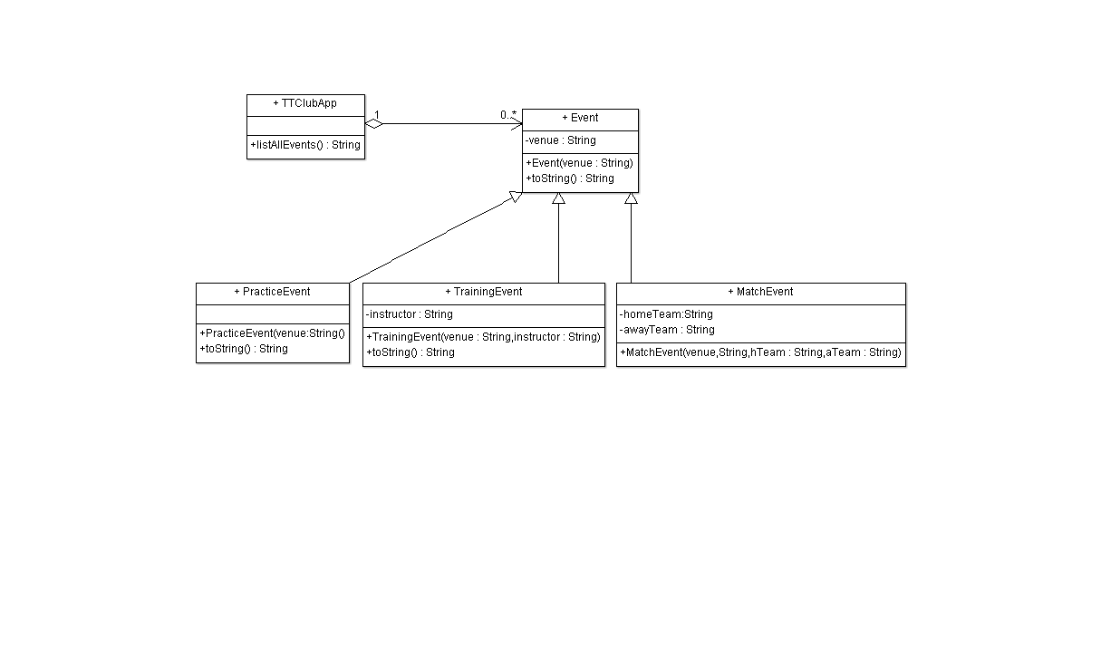

Slide 18
Example: Inheritance and polymorphism
Identify suitable classes: Event, PracticeEvent, TraingEvent and MatchEvent and TTClubApp or main – 5 marks
Event – 3 mark
Abstract , Contains attribute venue, method toString() or equivalent
Practice event – 2 mark
Extends events, Specialised toString()
TrainingEvent – 3 marks
Extends Event, Contains additional attribute instructor, Override toString()
MatchEvent – 3 marks
Extends Event, Contains additional attribute hTeam, aTeam, Override toString()
Upto 15 marks

Slide 19
Implement your design (20 marks)

Slide 20
Event
public abstract class Event {
private String venue;
Event(String venue){
this.venue=venue;
}
@Override
public String toString() {
return "venue=" + venue;
}
}

Slide 21
PracticeEvent
public class PracticeEvent extends Event {
PracticeEvent(String venue) {
super(venue);
}
@Override
public String toString() {
return "PracticeEvent in: " + super.toString();
}
}

Slide 22
TrainingEvent
public class TrainingEvent extends Event {
private String instructor;
TrainingEvent(String venue, String instructor) {
super(venue);
this.instructor=instructor;
}
@Override
public String toString() {
return "TrainingEvent in: " + super.toString() + " with instructor "+ instructor;
}
}

Slide 23
MatchEvent
public class MatchEvent extends Event {
private String hTeam, aTeam;
MatchEvent(String venue, String hTeam, String aTeam) {
super(venue);
this.hTeam= hTeam;
this.aTeam= aTeam;
}
@Override
public String toString() {
return "MatchEvent in: " + super.toString() + " home team "+ hTeam +" vs Away Team "+ aTeam;
}
}

Slide 24
TTClubApp
public class TTClubApp {
private ArrayList<Event> allEvents=new ArrayList<Event>();
public void populateData() {
//populate some data
allEvents.add(new PracticeEvent("Filton"));
allEvents.add(new TrainingEvent("Filton", "brian"));
allEvents.add(new MatchEvent("Filton", "FiltonB", "AlmondsA"));
allEvents.add(new TrainingEvent("Filton", "Paul"));
allEvents.add(new MatchEvent("Filton", "FiltonC", "AlmondsB"));
}
public String listAllEvents() {
String res = "";
for (Event e:allEvents){
res+=e.toString()+"\n";
}
return res;
}

Slide 25
TTClubApp
public static void main(String [] args){
TTClubApp tt= new TTClubApp();
tt.populateData();
System.out.println(tt.listAllEvents());
}

Slide 26
Example: Inheritance and polymorphism
Consistency with design 3 marks
Event – 2 mark
Definition of constructor, Definition of method toString() or equivalent
PracticeEvent – 1 mark
Definition of method Override toString()
TrainingEvent – 3 marks
Definition of constructor, Definition of method Override toString()
MatchEvent – 3 marks (similar to TrainingEvent)
Club (main method) – total 5 marks, includes:
Collection of Events – (1 marks)
Creating some suitable instances of TraingEvent and MatchEvent – (1 marks)
Use of array or some kind of list (1 mark)
Sending the same message to the references – (2 marks)
Correct syntax – 1 mark

Slide 27
Output
PracticeEvent in: venue=Filton
TrainingEvent in: venue=Filton with instructor brian
MatchEvent in: venue=Filton home team FiltonB vs Away Team AlmondsA
TrainingEvent in: venue=Filton with instructor Paul
MatchEvent in: venue=Filton home team FiltonC vs Away Team AlmondsB

